Slide 1

Let me do it for you - Automating OSINT and Recon
Paul Zenker
https://danielmiessler.com/p/ai-influence-level-ail/

Slide 2

About
Paul Zenker / IT Security Analyst
Offensive Security Certified Professional (OSCP)
E: pzenker@nsideattacklogic.de
Security-by-accident.com

Slide 3
Agenda
Why and Where?
Basics -> Intermediate
Help you come up with ideas
Coming up with a structure
showcasing tools, libraries and concepts
and of course… AI
comics and memes

Slide 4
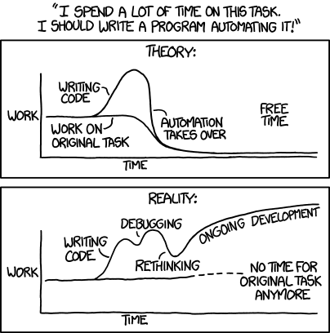
Why and Where?
the intern
reused
(almost) no moving parts
source: https://xkcd.com/1319/

Slide 5
How?
Using tools
coding yourself
using automation frameworks

Slide 6
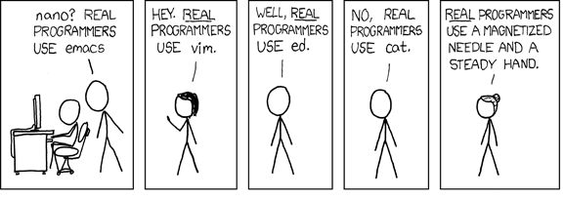
Python the Greatest Hits
source: https://xkcd.com/1319/

Slide 7
Python Libraries
Requests and APIs
Telegram, Discord and Co.
Search Engines
Facial Recognition
Natural Language Processing
Flask
Regex
Selenium
Beautifulsoup

Slide 8

Python Libraries – Why code blocks?

Slide 9
Python Libraries - Requests and APIs
On the shoulders of giants
All the data you need
Libraries vs. native APIs
You can also get the HTML of websites
import shodan
api = shodan.Shodan(SHODAN_API_KEY)
results = api.search('apache')
for result in results['matches']:
print(result)

Slide 10
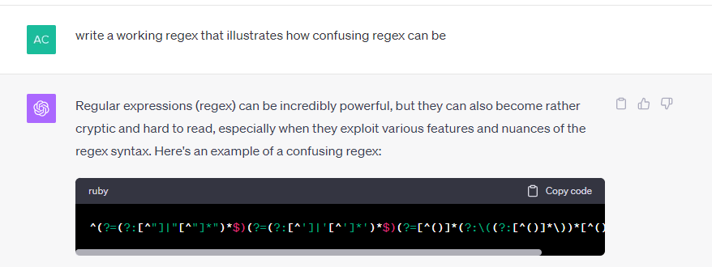
Python Libraries - Regex
Find anything anywhere
So powerful 🏋️‍♂️
So confusing ( •᷄‎_•᷅ )
Use AI
^(?=(?:[^"]|"[^"]*")*$)(?=(?:[^']|'[^']*')*$)(?=[^()]*(?:\((?:[^()]*\))*[^()]*\)*$))
Source: https://shodan.readthedocs.io/en/latest/

Slide 11
Python Libraries – Telegram, Discord & Co.
import discord
from discord.ext import commands
import subprocess
TOKEN = 'YOUR_DISCORD_BOT_TOKEN'
intents = discord.Intents.all()
bot = commands.Bot(command_prefix='!', intents=intents)
@bot.command()
async def scan(ctx):
"""Runs the recon.sh script without waiting for it to finish"""
try:
subprocess.Popen(["/root/recon.sh"], shell=True)
await ctx.send("Script is running in the background.")
except Exception as e:
await ctx.send(f"Error executing script: {str(e)}")
bot.run(TOKEN)
Starting things
Notifications
Assistants

Slide 12
Python Libraries – Search Engines
Like Google Dorking
…but on steroids
Test if dangerous dork has results
from duckduckgo_search import DDGS
with DDGS() as ddgs:
for r in ddgs.text('OSINT filetype:pdf',
safesearch='off',
timelimit='y',
max_results=10):
print(r)
Source: https://pypi.org/project/duckduckgo-search

Slide 13
Python Libraries – Facial Recognition and NLP
Libraries exist
Make advanced use cases possible
Limited reliability
from textblob import TextBlob
testimonial = TextBlob("Textblob is amazingly simple to use. What great fun!")
print(testimonial.sentiment)
>>> Sentiment(polarity=0.39166666666666666, subjectivity=0.4357142857142857)
Source: https://textblob.readthedocs.io/en/dev/quickstart.html

Slide 14
Python Libraries - Flask
Integrating tools with other tools
Making tools available
from flask import Flask, jsonify
app = Flask(__name__)
@app.route('/')
def hello_world():
return jsonify(message="Hello, World!")
@app.route('/api/greet/<string:name>', methods=['GET'])
def greet(name):
return jsonify(message=f"Hello, {name}!")
if __name__ == '__main__':
app.run(debug=True)

Slide 15
Python Libraries – Beautifulsoup + Selenium
Beautifulsoup for scraping
Selenium for browser interaction
Together = unstoppable
from bs4 import BeautifulSoup
from selenium import webdriver
driver = webdriver.Chrome()
URL = 'https://example.com'
driver.get(URL)
page_source = driver.page_source
soup = BeautifulSoup(page_source, 'html.parser')
paragraphs = soup.find_all('p')
for p in paragraphs:
print(p.text)

Slide 16
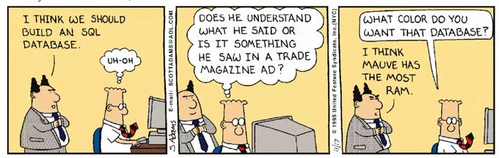
Storing Data
source: Scott Adams Dilbert

Slide 17
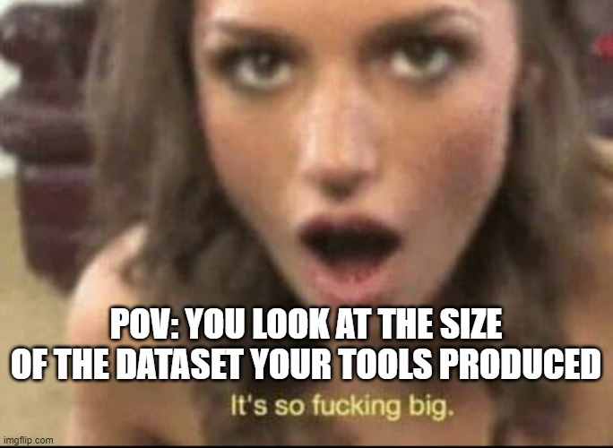
Database Options
SQL
MongoDB
Neo4j
Grafana
Some more fancy stuff

Slide 18
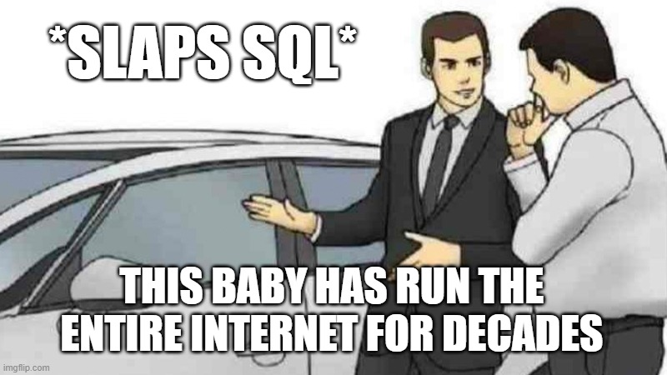
Database Options - SQL
Gets you where you need to go
Well documented

Slide 19
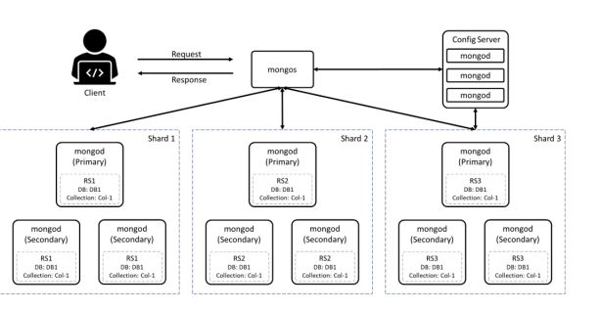
Database Options - MongoDB
- stored as documents
- uses JSON
Quelle: https://i0.wp.com/digitalvarys.com/wp-content/uploads/2019/09/Introduction-to-MongoDB.png?resize=1024%2C563&ssl=1

Slide 20
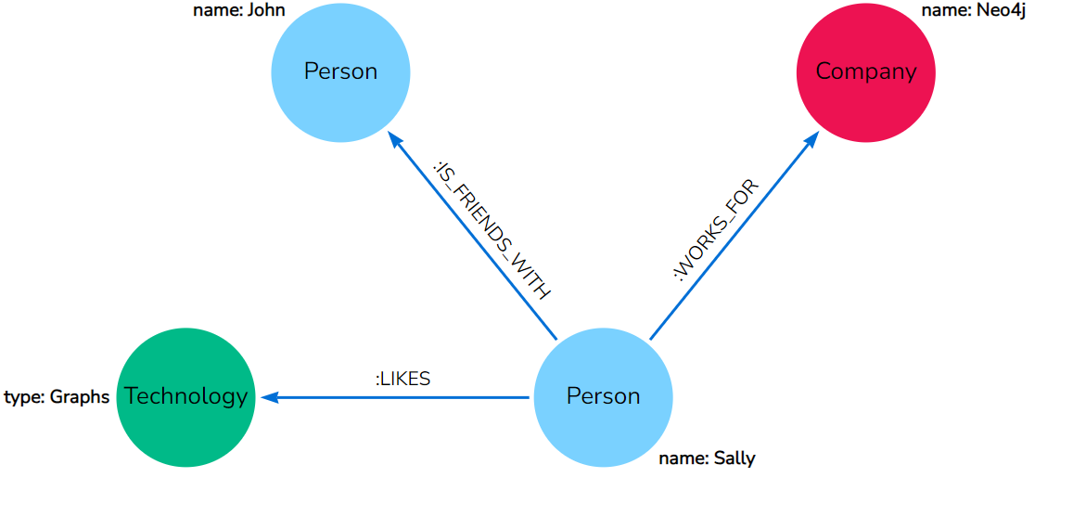
Database Options – Neo4j
Graph database
Visualizes relationships
Gets messy really quick
source: https://neo4j.com/docs/getting-started/_images/cypher_graph_v1_arr.svg

Slide 21
Database Options – Fancy stuff
InfluxDB – time series data
Redis – in memory
Every cloud provider has a DB option
There is a DB for everything

Slide 22
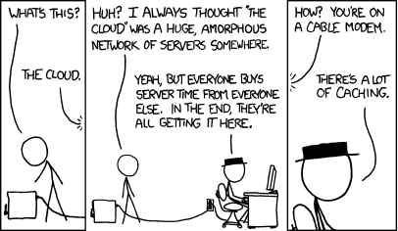
Deploying and the Cloud
source: https://xkcd.com/908/

Slide 23
Deploying and the Cloud
Docker
Portainer
Render
Database Hosting
The real cloud

Slide 24
Deploying - Docker
Normal setup
Install go
Add go to path
Add go binaries to path
Setup something to do it in every terminal
Install subfinder
Run subfinder
Almost all tools have Docker images
No dependency conflicts
Docker setup
docker run projectdiscovery/subfinder:latest -d hackerone.com

Slide 25
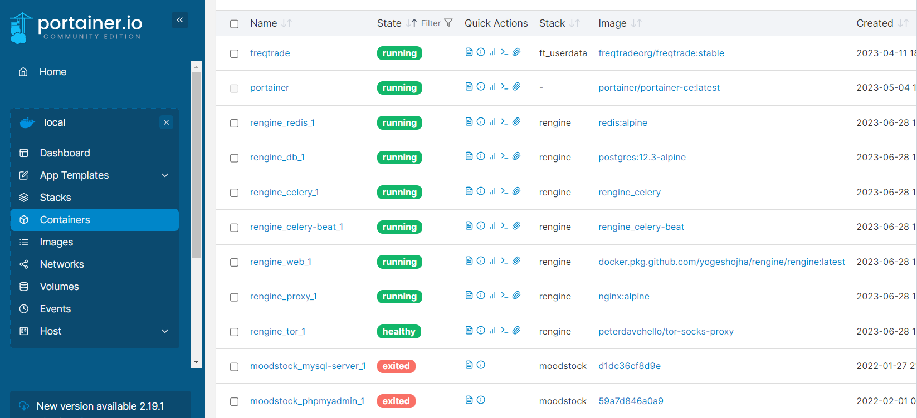
Deploying - Portainer
It is like Docker
But with a GUI
And selfhosted
And beautiful ✨

Slide 26
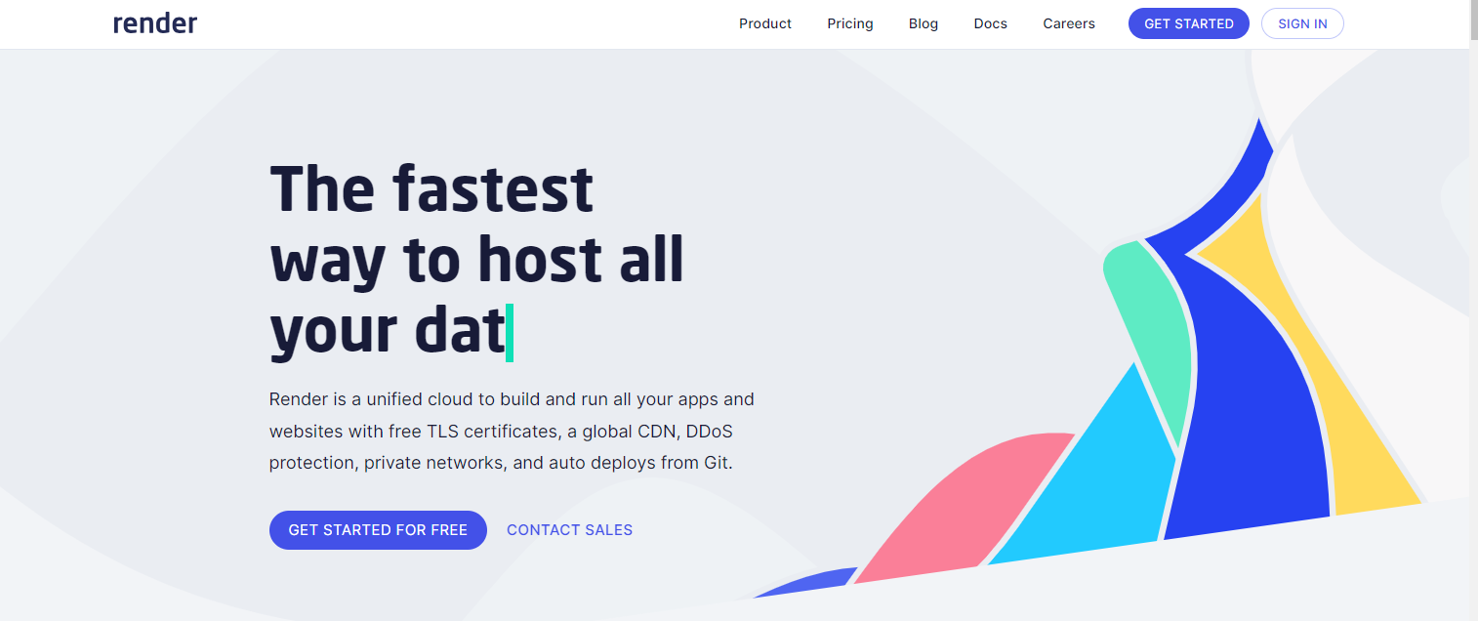
The Cloud - Render
Websites
APIs
Databases
For free
With Github integration

Slide 27
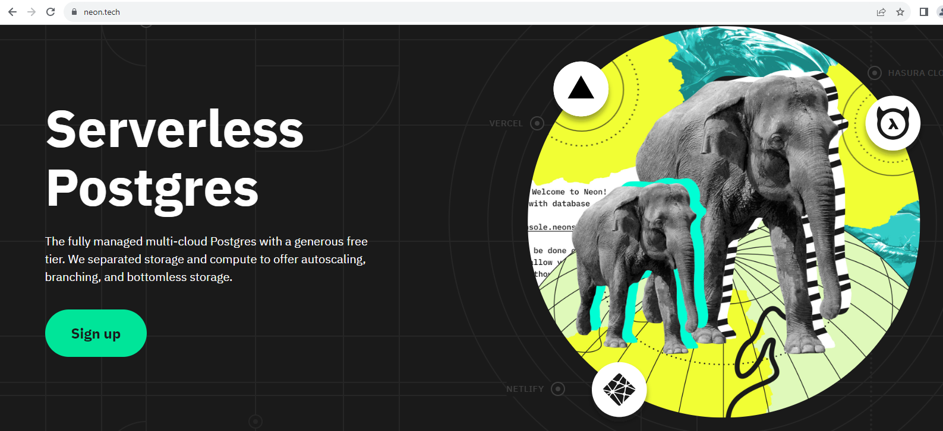
The Cloud – Database Hosting
Free tiers for cloud hosted DBs
Reduces setup and maintenance
Trust?
source: neon.tech

Slide 28
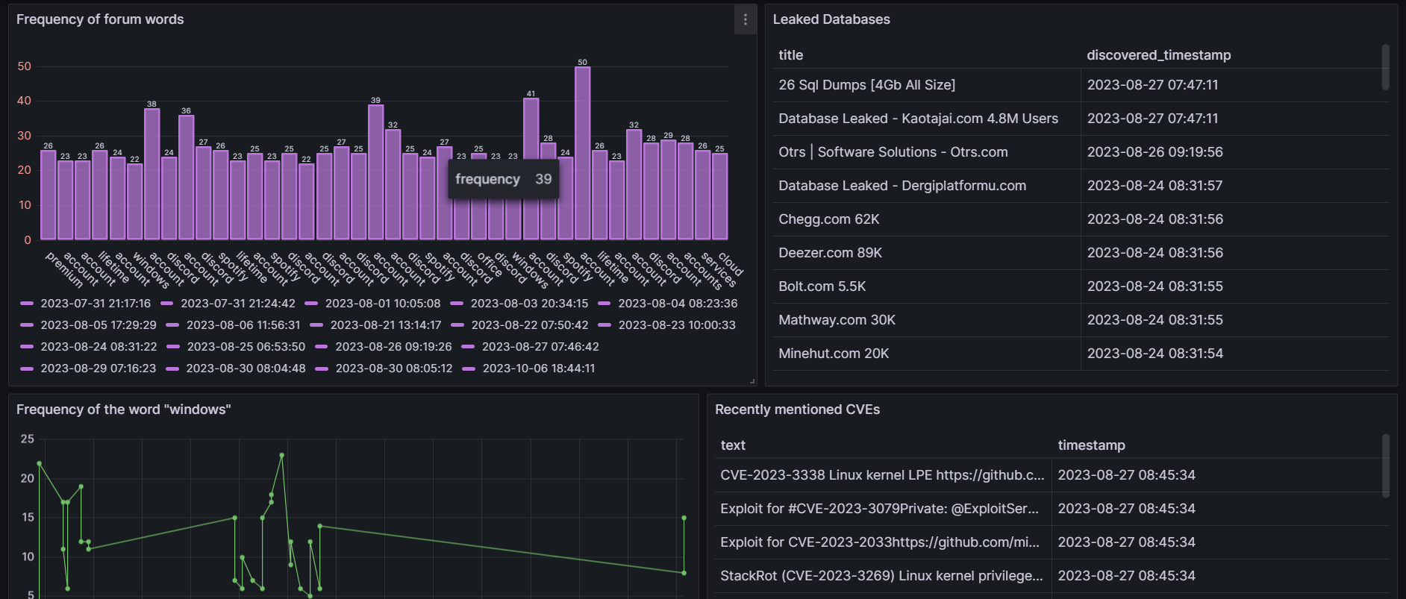
The Cloud – Grafana
Make beautiful charts
Build nice dashboards
Give your tools a “frontend”

Slide 29

The Cloud -The Real Cloud
There is a cloud service for everything
Cost?
Scaling to the moon🚀
source: https://www.reddit.com/r/ProgrammerHumor/comments/xkadmh/150k_bill/

Slide 30
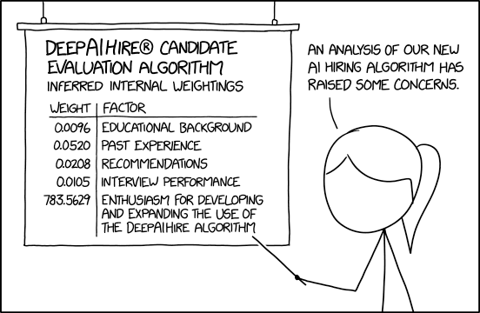
AI
source: https://xkcd.com/2237/

Slide 31
AI
ChatGPT
Local AI models
Training with own data

Slide 32
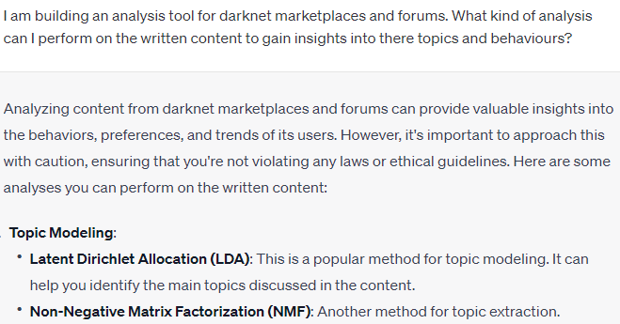
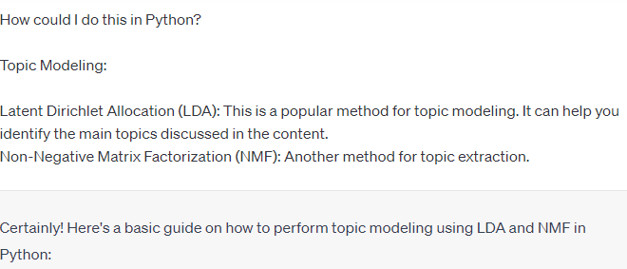
AI - ChatGPT
Web scraping
Coding
Architecture design

Slide 33
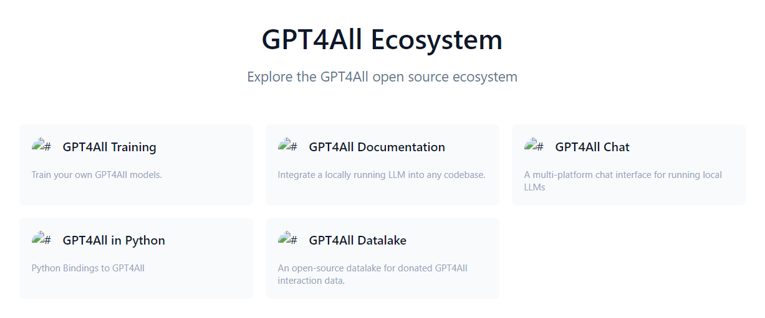
AI – Local Models
Privacy respecting (check settings)
Can be embedded in code without expensive API
Surprisingly, resource efficient
Source: https://gpt4all.io/index.html

Slide 34

AI – Training your own model
I am not an expert on it
Pretty interesting tho
Source: https://gpt4all.io/index.html

Slide 35
Big Nonos
Storing keys
Trust every pip and npm library
Trust all of ChatGPTs code
Forget about unsecured test systems
source: https://xkcd.com/2237/

Slide 36
Tying it all together - ideas
Discord and Telegram bot to control it
Crawler on Docker
Scanning tool on Docker
Scanning tool on Docker
Database in the Cloud
Grafana Dashboard

Slide 37
Considerations
What is your scope?
Is there a rate limit?
Active vs. Passive?
Should I release this?

Slide 38
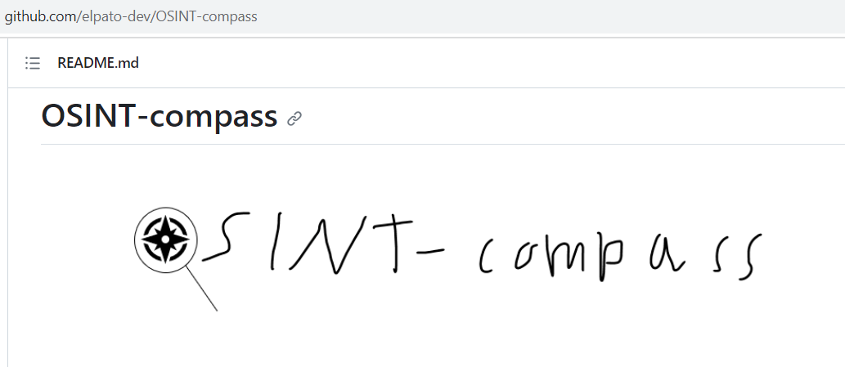
Tying it all together
Can there be a one and only framework?
Please send me your work via email, X, pidgeon, etc…!

Slide 39
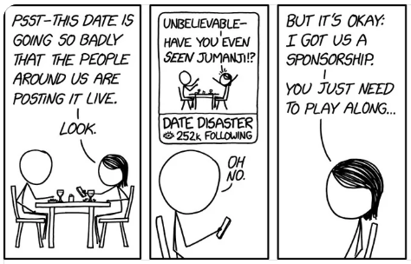
Tools Speed Dating
source: https://xkcd.com/2698

Slide 40
Tools Speed Dating -The Tools
Spiderfoot
ProjectDiscovery
Nuclei
Subfinder
Httpx
Notify
Automation frameworks
n8n
Apache Airflow
BabyAGI
langchain
All of TomNomNoms stuff
Maltego
Netlas.io
Search.0t.rocks
Awesome Selfhosted
Cipher387
Start.Me

Slide 41
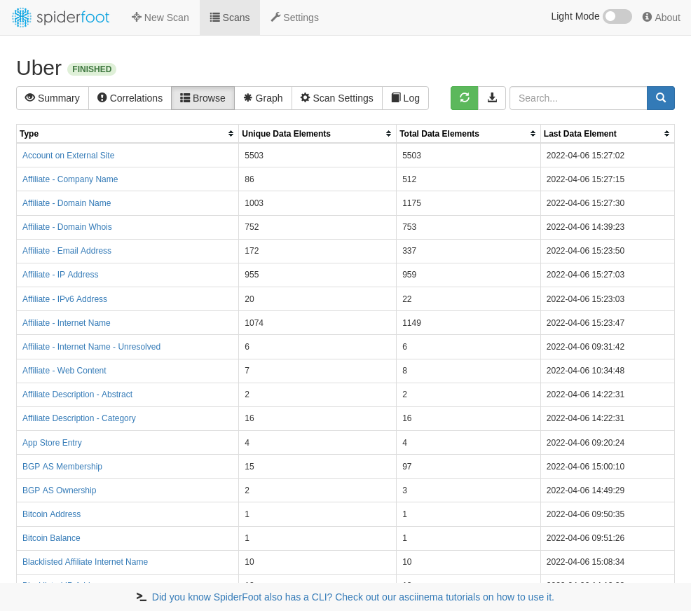
Tools Speed Dating - Spiderfoot
source: https://github.com/smicallef/spiderfoot

Slide 42
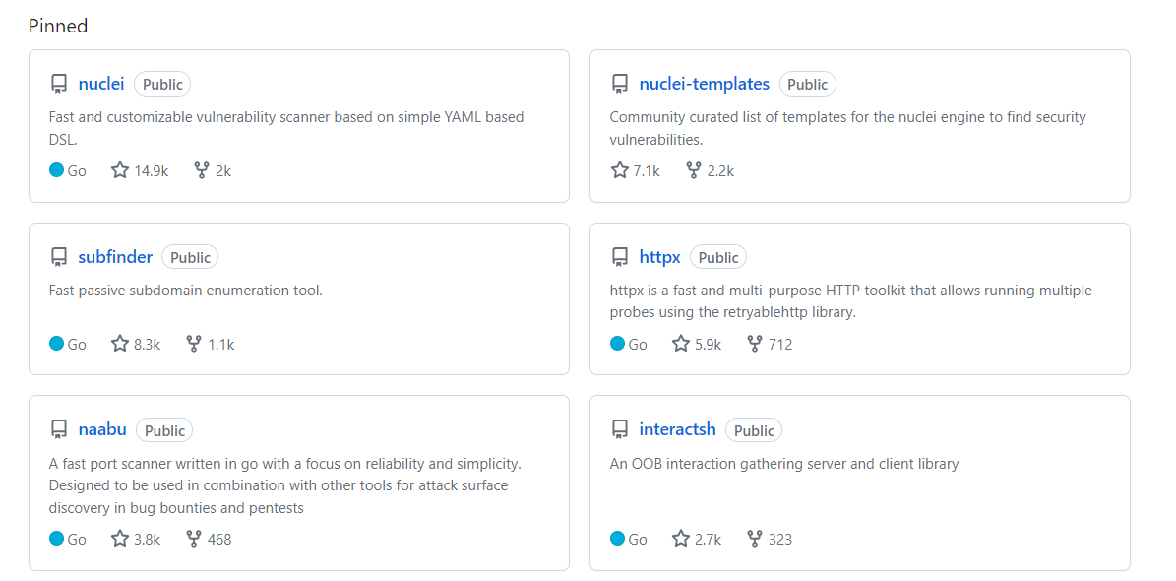
Tools Speed Dating - ProjectDiscovery
Source:https://github.com/projectdiscovery

Slide 43
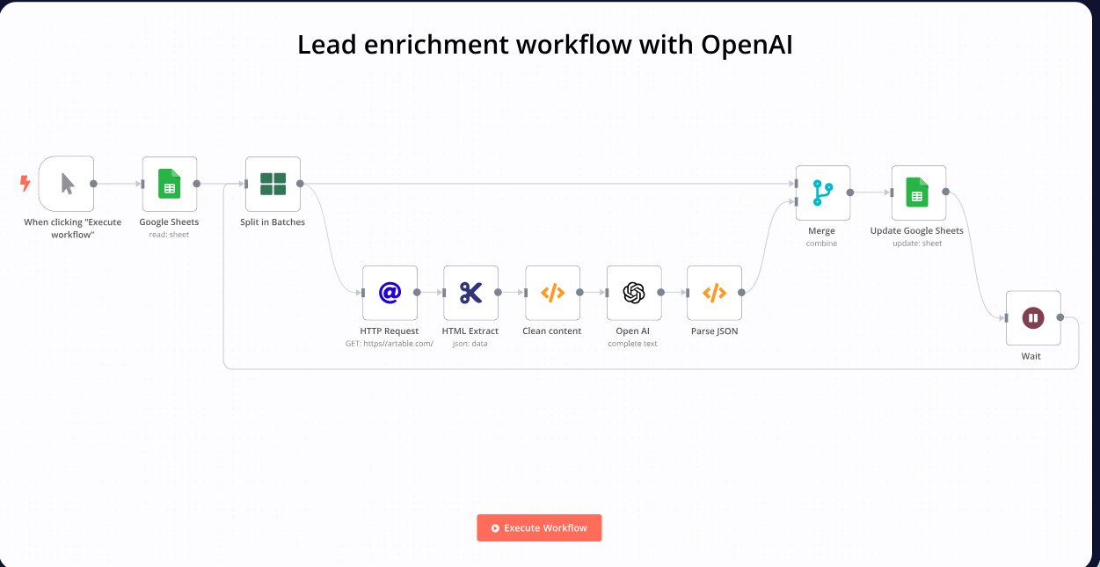
Tools Speed Dating – n8n
Source:https://n8n.io

Slide 44
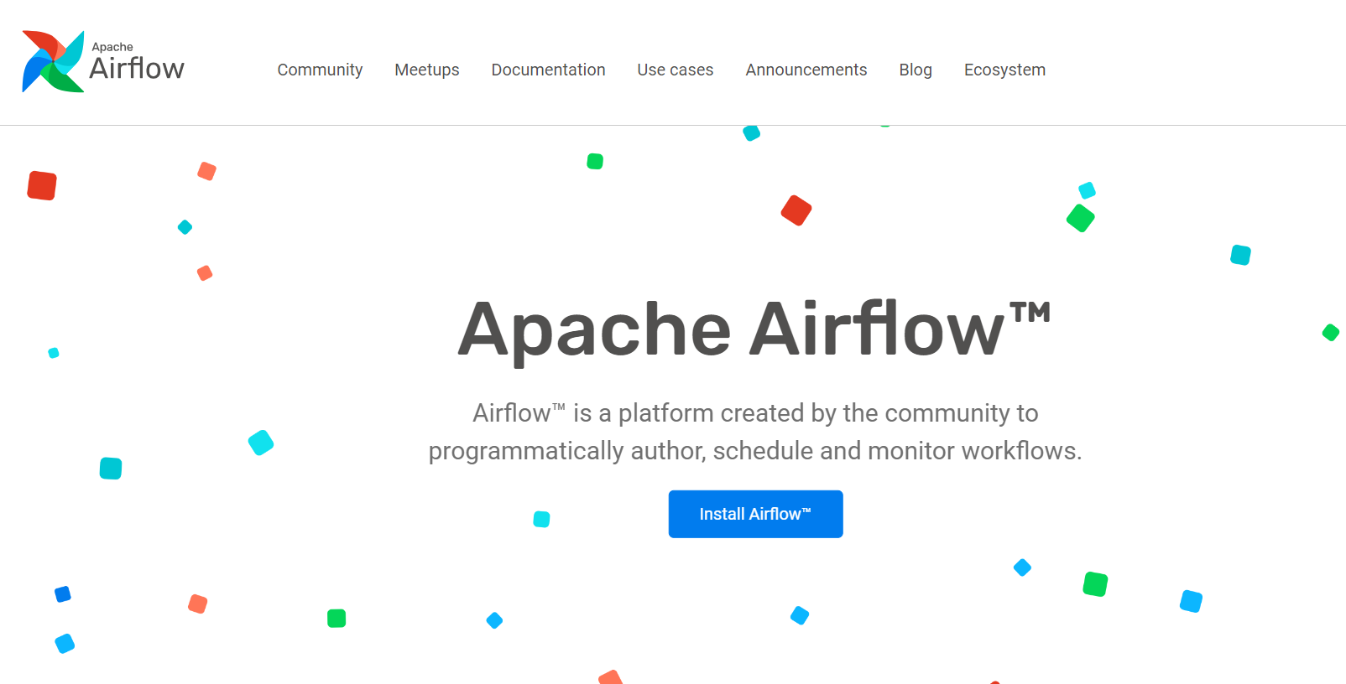
Tools Speed Dating – Apache Airflow
Source:https://airflow.apache.org/

Slide 45
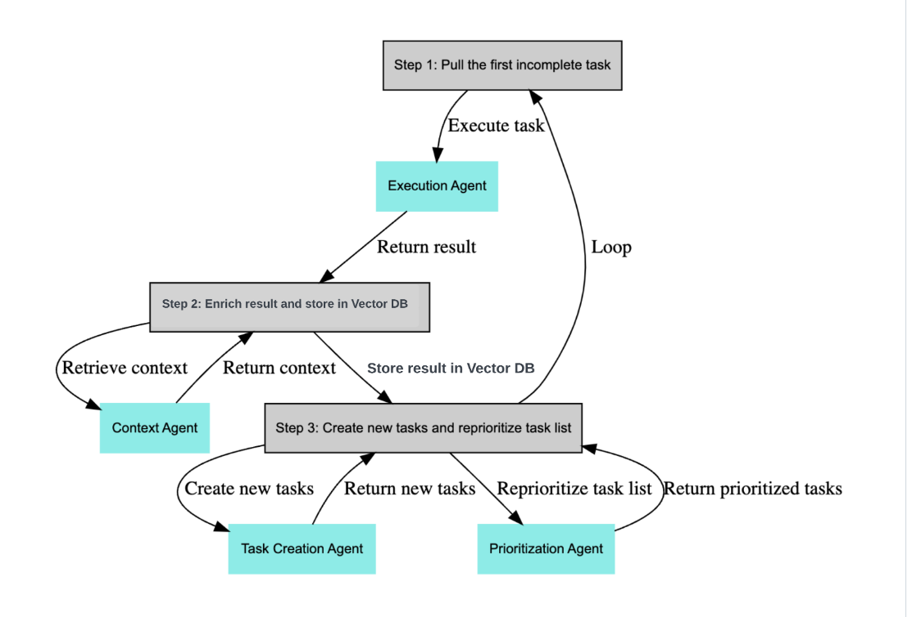
Tools Speed Dating – BabyAGI
Source: https://github.com/yoheinakajima/babyagi

Slide 46
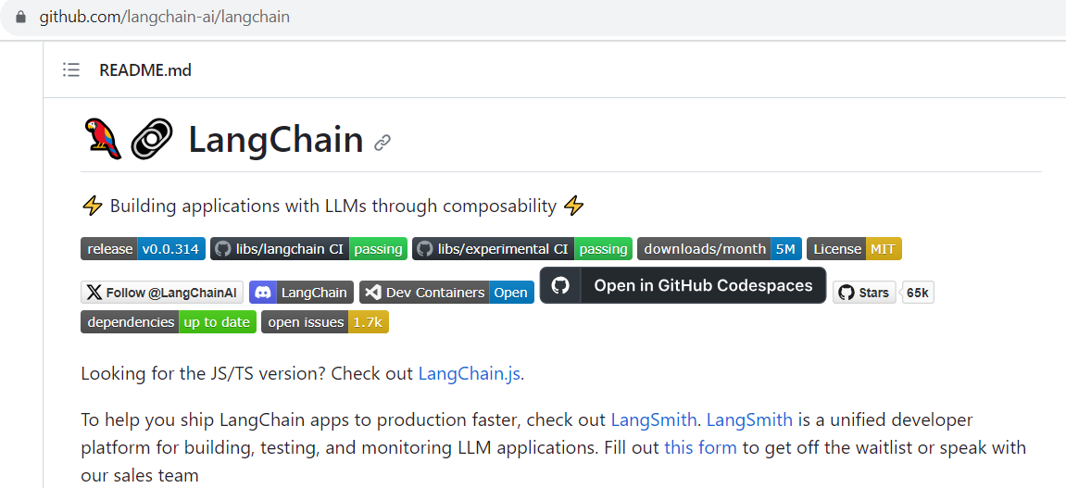
Tools Speed Dating – langchain
Source: https://github.com/langchain-ai/langchain

Slide 47
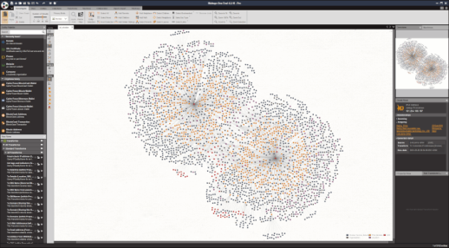
Tools Speed Dating – Maltego
Source: https://www.maltego.com/img/maltego-desktop-client.png

Slide 48
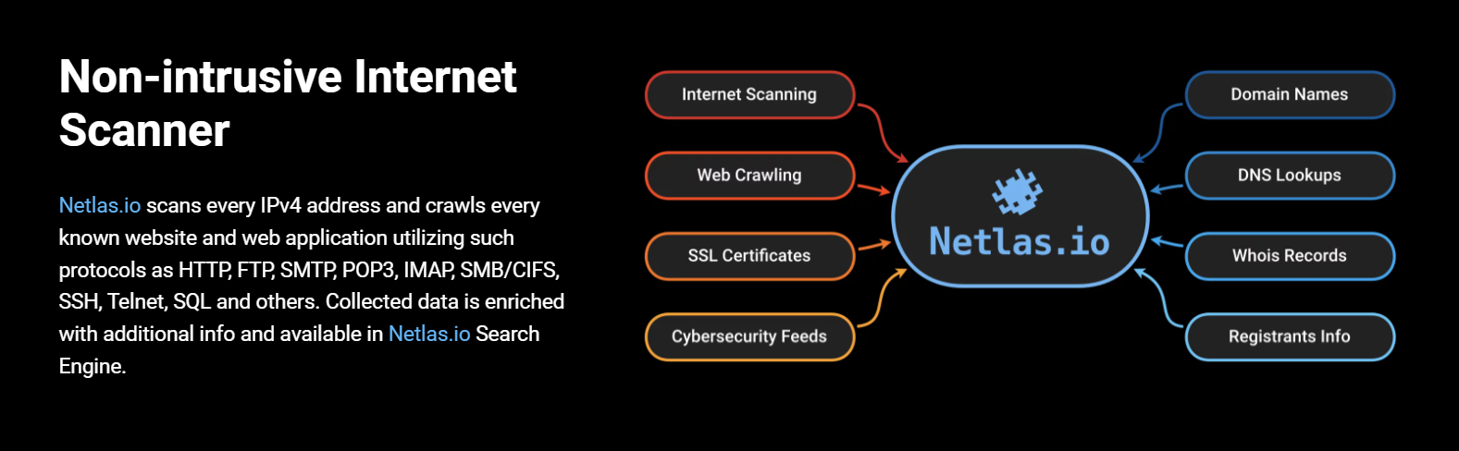
Tools Speed Dating – Netlas.io
Source: https://netlas.io/

Slide 49
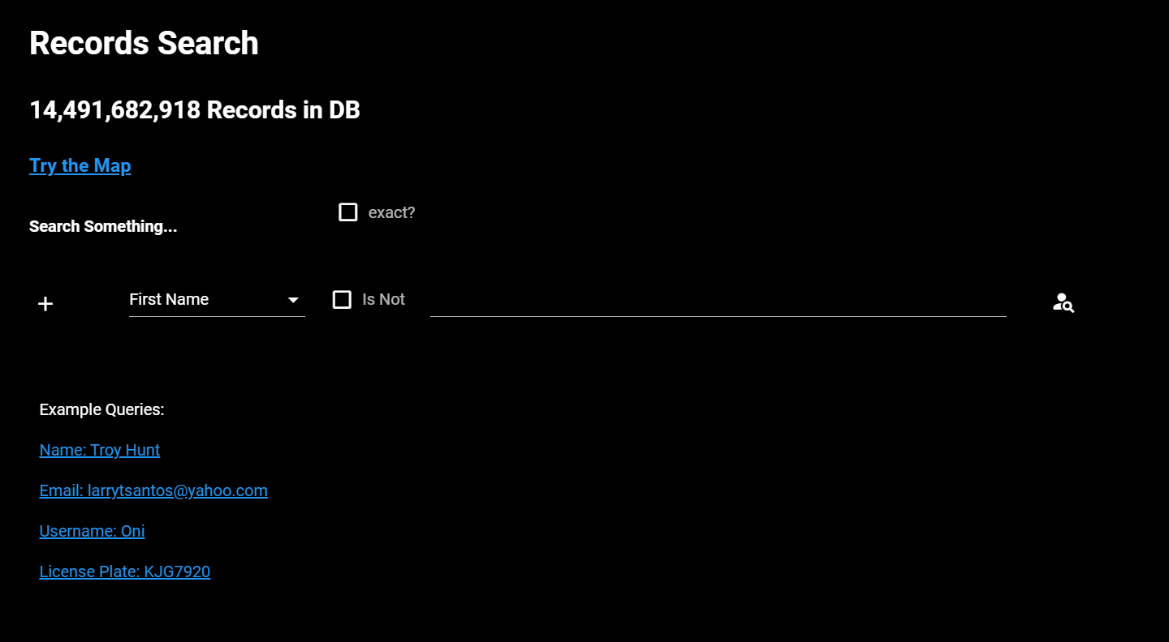
Tools Speed Dating – search.0t.rocks
Source: https://search.0t.rocks/

Slide 50
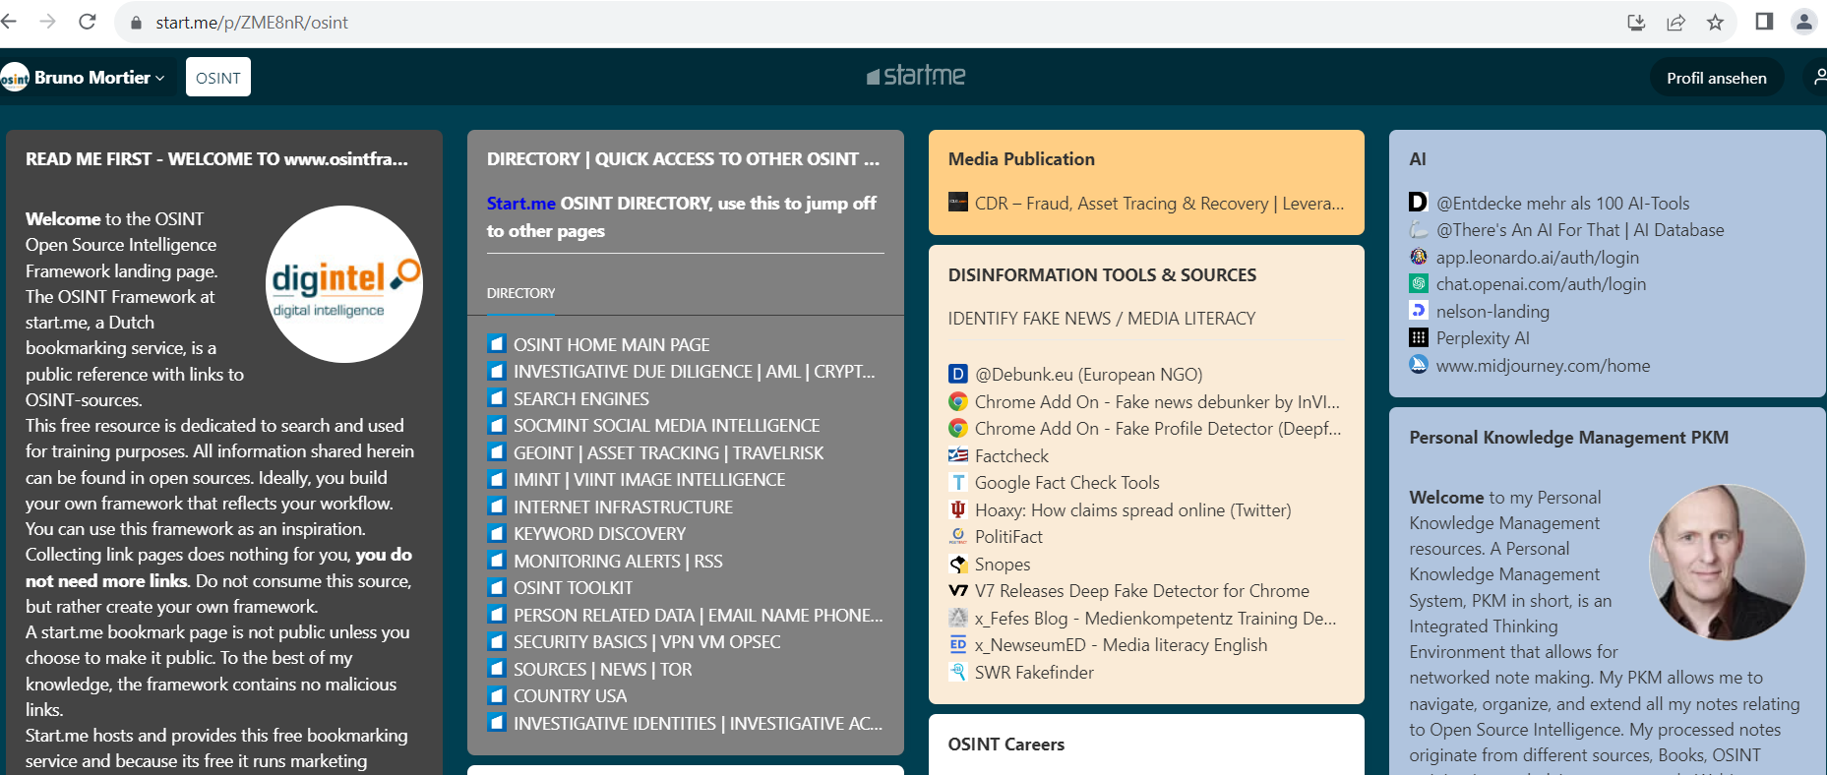
Tools Speed Dating – start.me
Source: https://start.me/

Slide 51
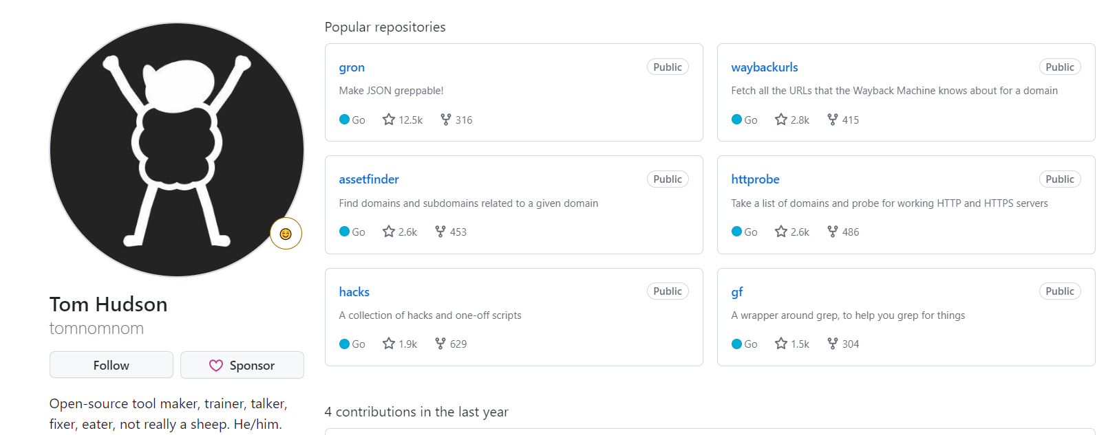
Tools Speed Dating – TomNomNom
Source: https://github.com/tomnomnom

Slide 52
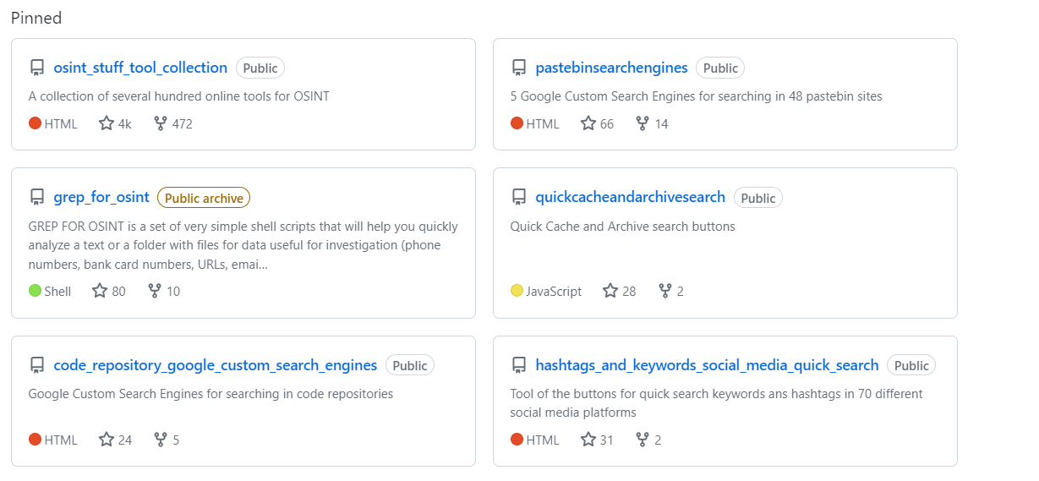
Tools Speed Dating – Cipher387
Source: https://github.com/cipher387

Slide 53
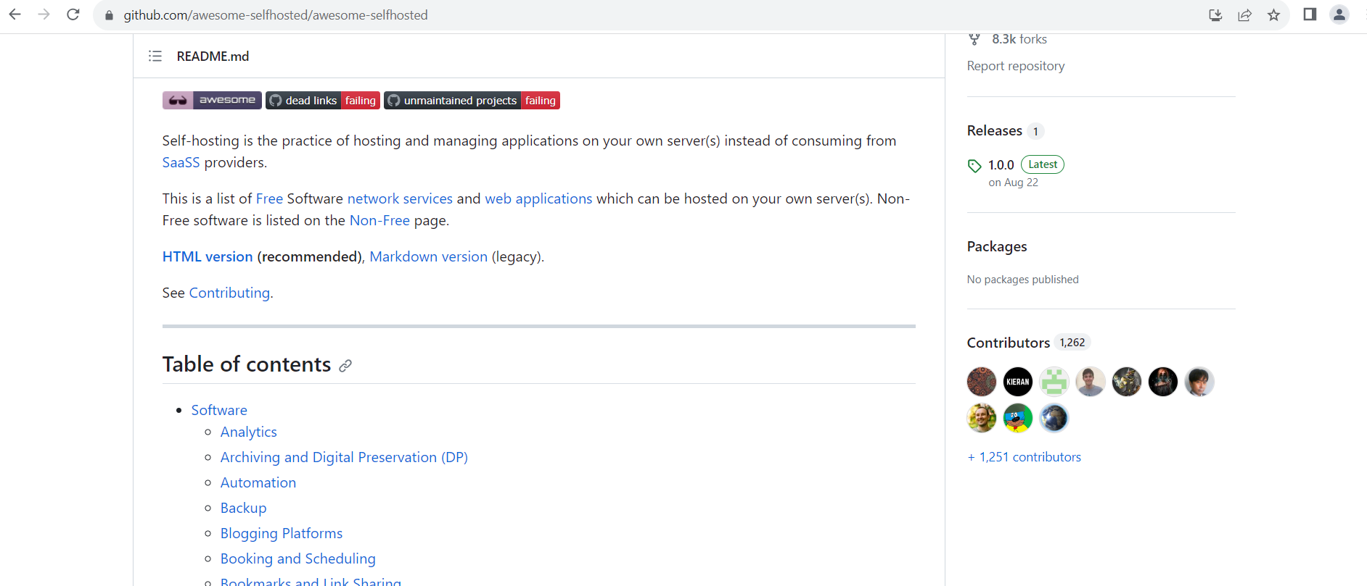
Tools Speed Dating – Awesome Selfhosted
Source: https://github.com/awesome-selfhosted/awesome-selfhosted

Slide 54

This OSINT thing sounds cool?
www.nsideattacklogic.de
info@nsideattacklogic.de
Agnes-Pockels-Bogen 1, 80992 München
+49 89 89 082 110
lockandstockphotos_golden-gate
Photo is open-sourced, and free for use without restrictions
http://lockandstockphotos.com/
http://lockandstockphotos.com/wp-content/uploads/2014/07/golden-gate.jpg
Photographed by: ajmontpetit.com
License: http://creativecommons.org/licenses/by-sa/4.0/legalcode

